Slide 1
Object Detection:
‘1-Stage Detector’ 소개
(R-CNN, Fast R-CNN, Faster R-CNN을 중심으로)
자료출처: Fastcampus 등

Slide 2
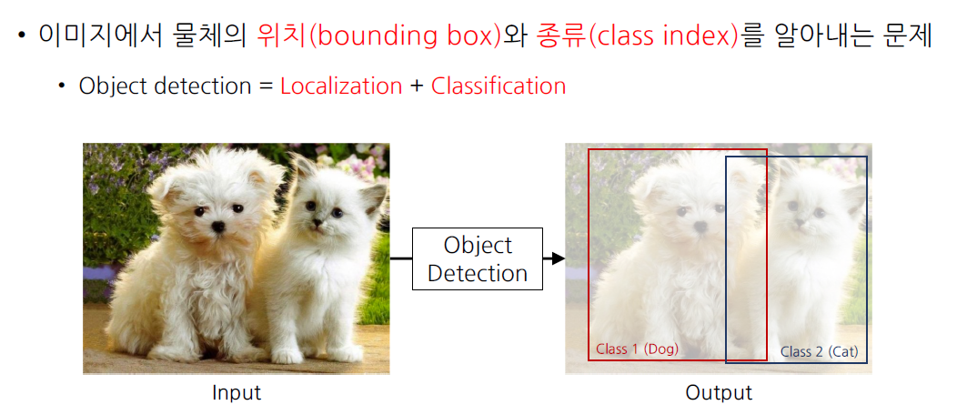
Object Detection이란?
Regression + Classification

Slide 3
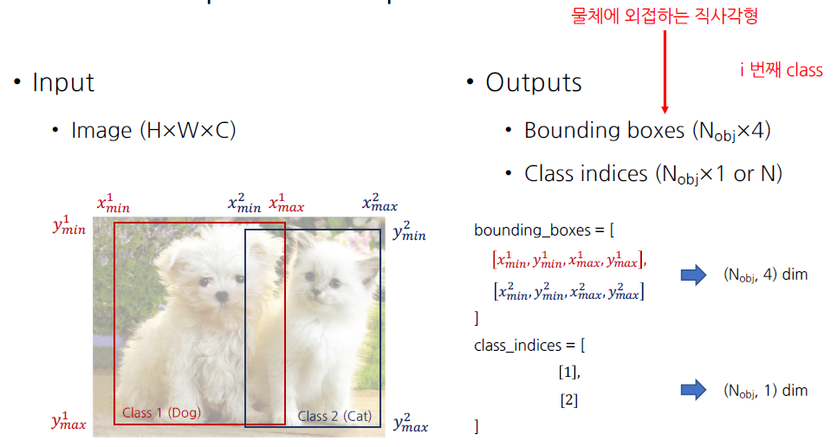
Input & Output

Slide 4
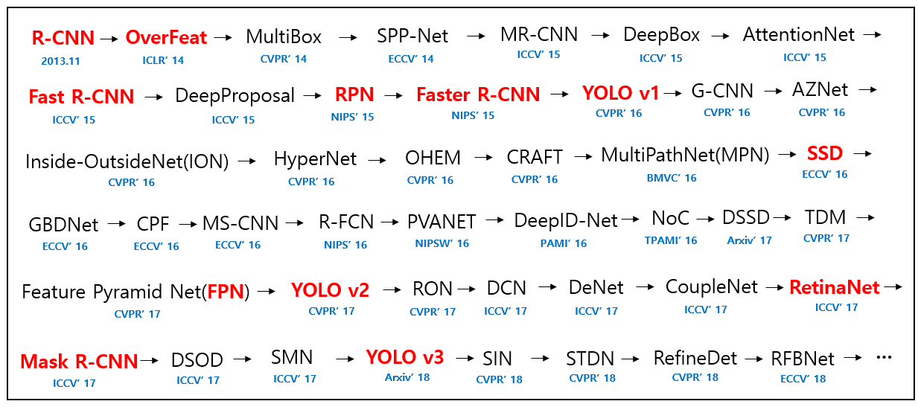
Paper List - since ‘2014
2-stage: R-CNN, SPP-NET, Fast R-CNN, Faster R-CNN
1-stage: Yolo v1,2,3, SSD, RetinaNet
source: https://github.com/hoya012/deep_learning_object_detection

Slide 5
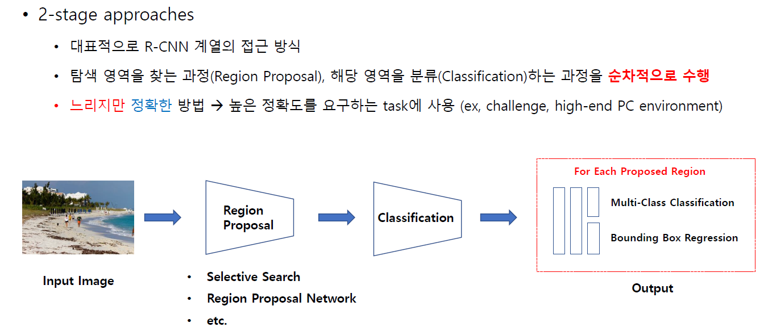
2-stage vs. 1-stage

Slide 6
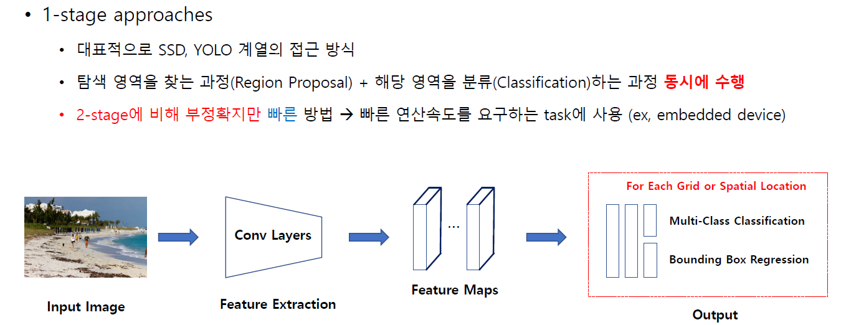
2-stage vs. 1-stage

Slide 7
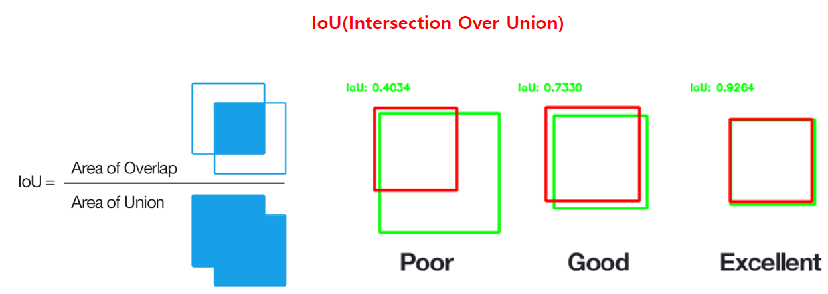
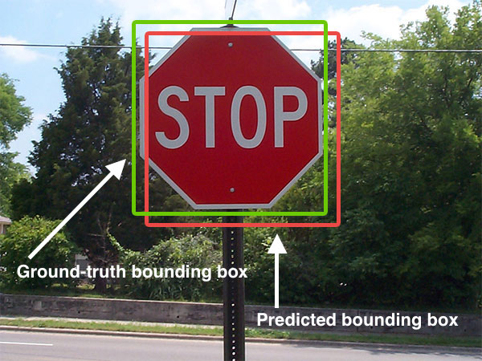
Background: Metric#1 - IoU
[IoU threshold]
VOC: 0.5
ImageNet: min (0.5, (w*h/((w+10)*(h+10)))
MS COCO: mAP@[.5 : .05 : .95]
average mAP over different IoU thresholds, from 0.5 to 0.95,
step 0.05 (0.5, 0.55, 0.6, 0.65, 0.7, 0.75, 0.8, 0.85, 0.9, 0.95)

Slide 8
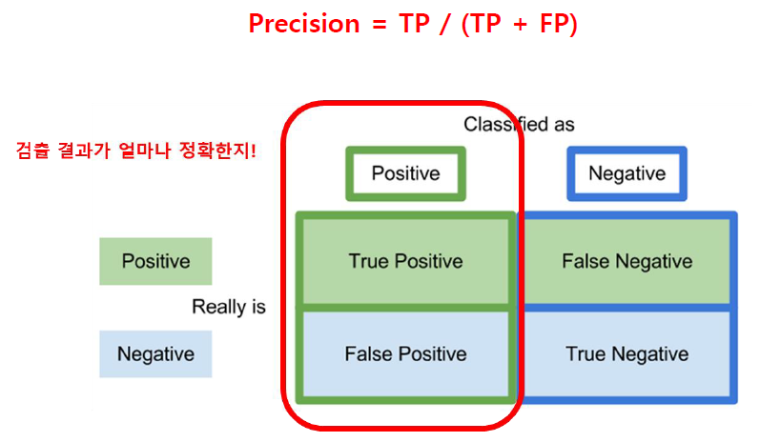
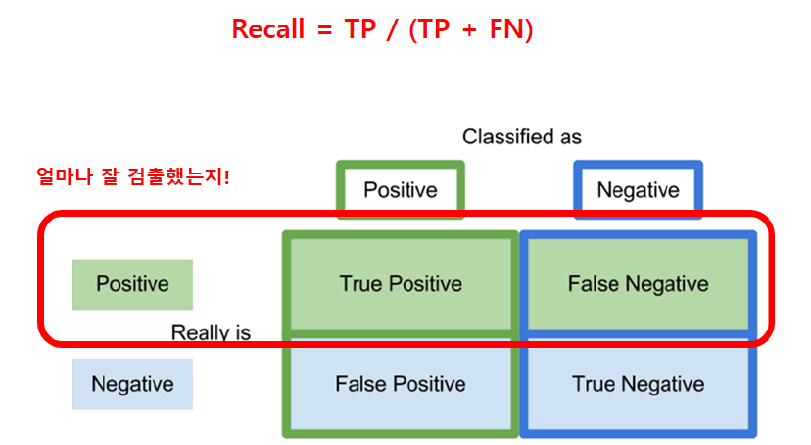
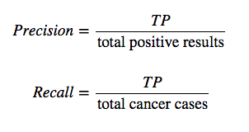
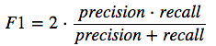
Background: Metric#2 - mAP
ex)

Slide 9
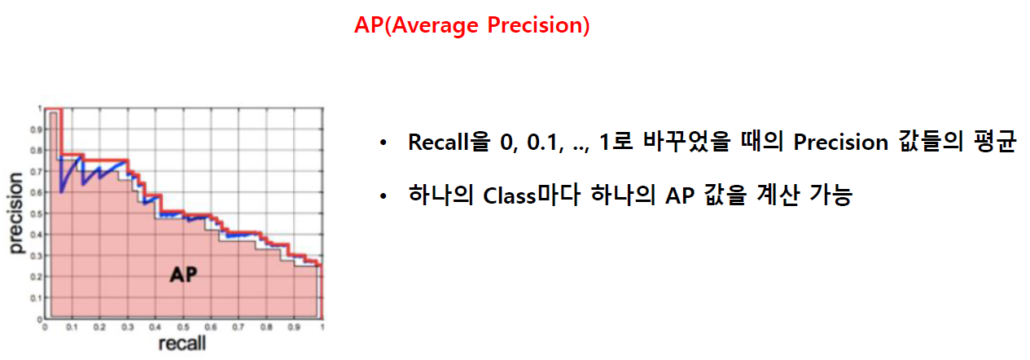
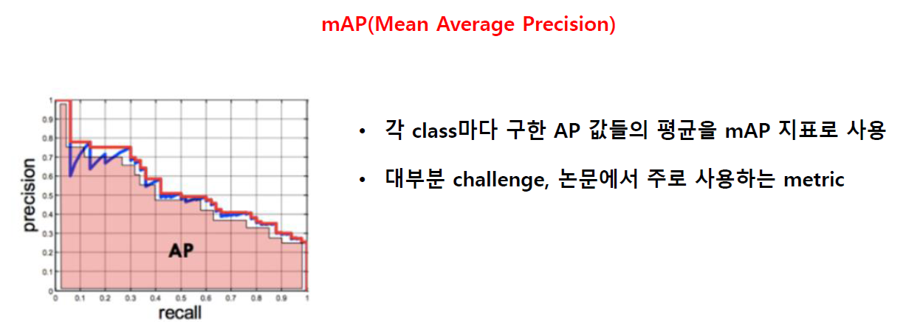
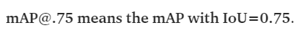
Background: Metric#2 - mAP

Slide 10
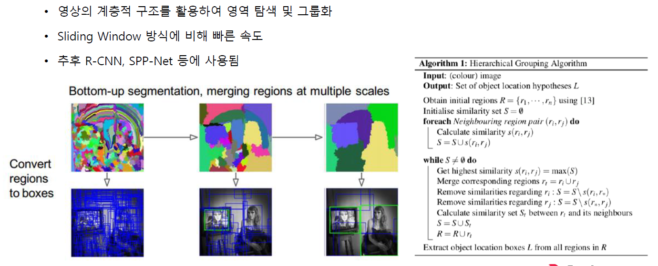
Background: 전통적인 Detection 알고리즘
Sliding Window
Selective Search: DL 이전 방법 중 가장 우수

Slide 11
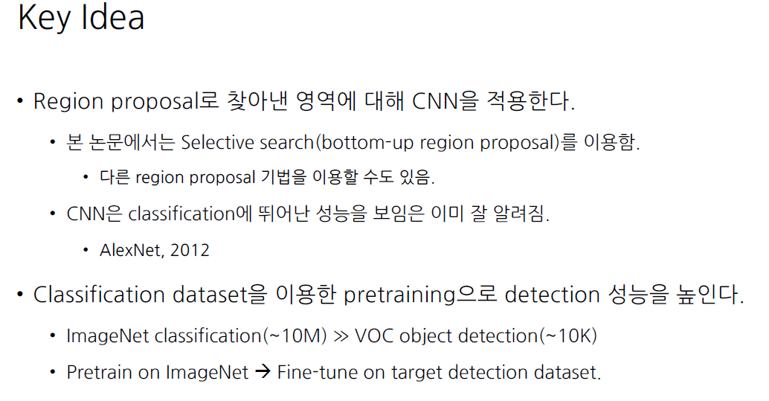
R-CNN, Region-based CNN (CVPR 2014)

Slide 12
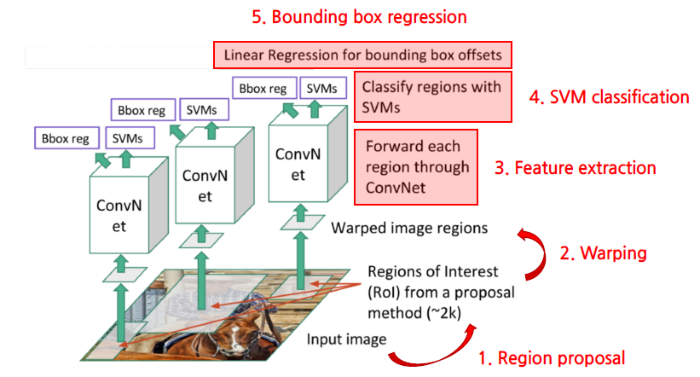
R-CNN: Overview

Slide 13
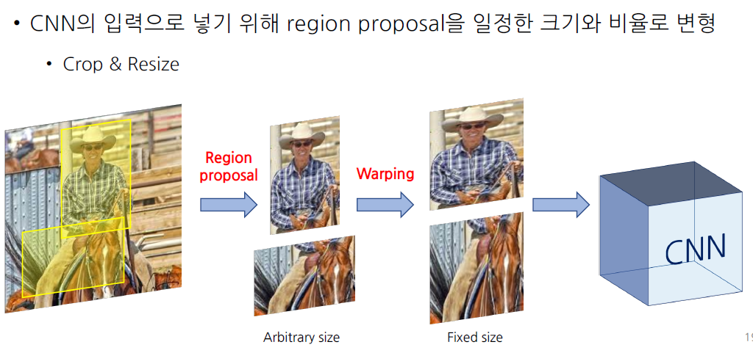
R-CNN: Warping

Slide 14
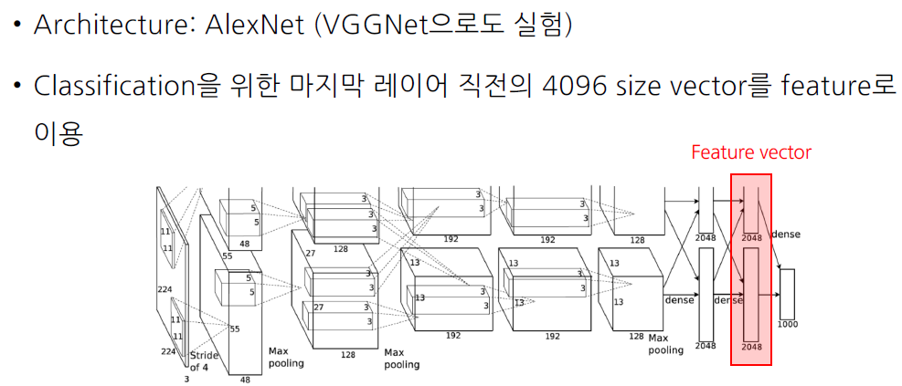
R-CNN: Feature Extraction

Slide 15
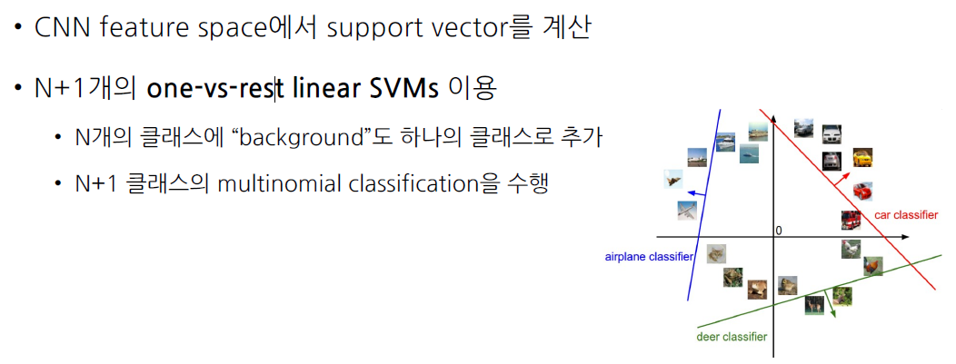
R-CNN: SVM Classification

Slide 16
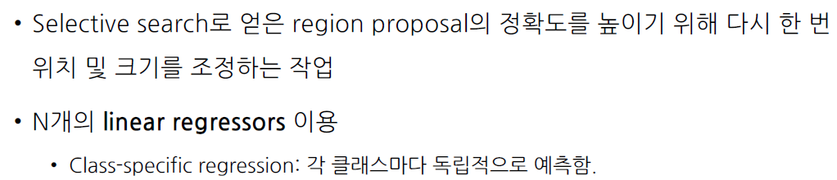
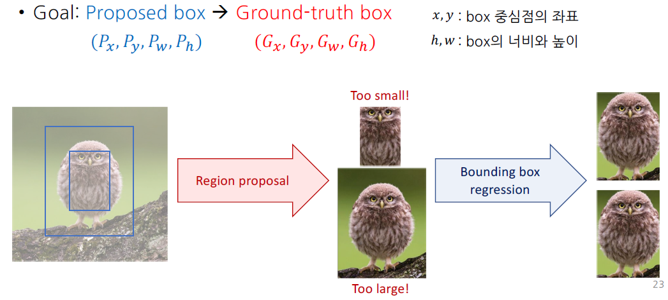
R-CNN: Bounding Box Regression

Slide 17
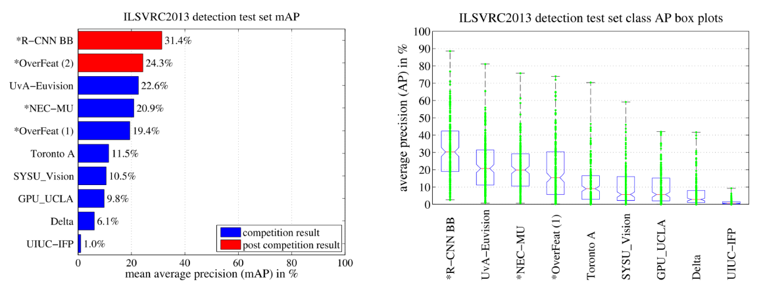
R-CNN: Performance – ILSVRC 2013

Slide 18
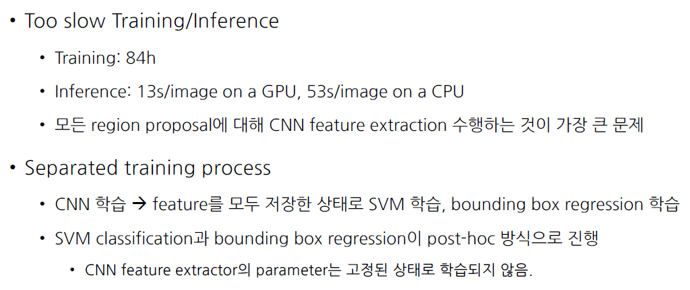
R-CNN: 단점

Slide 19
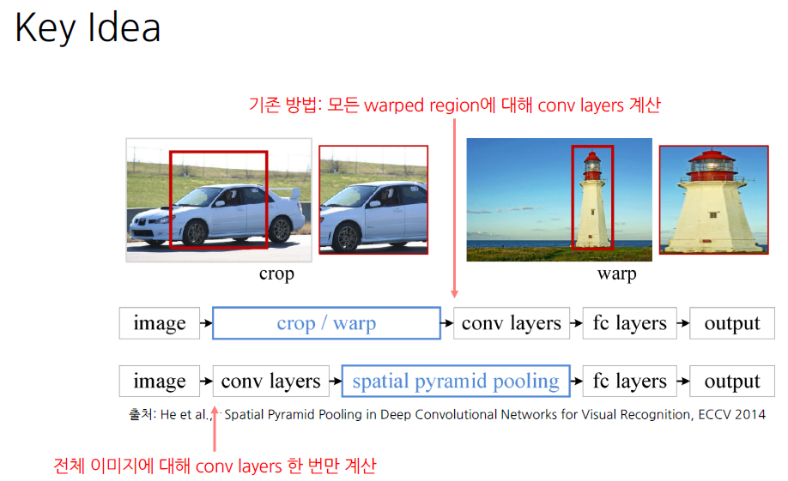
SPP-Net (ECCV 2014)

Slide 20
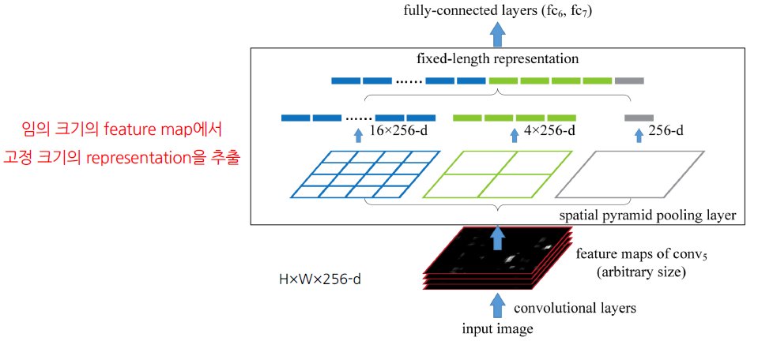
SPP-Net: Spatial Pyramid Pooling

Slide 21
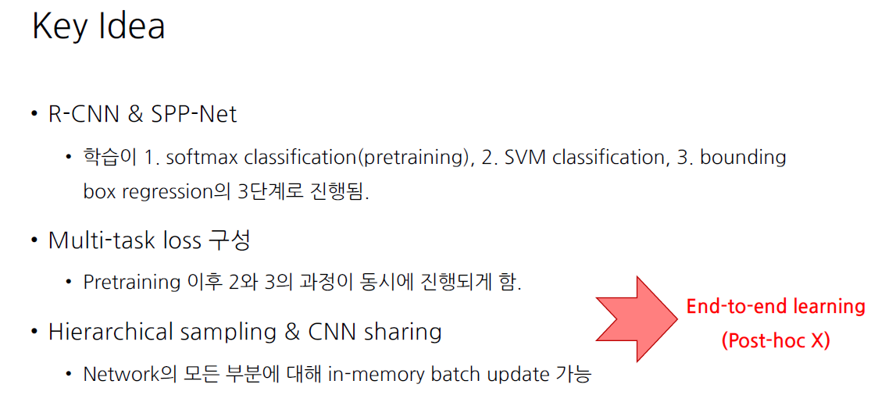
Fast R-CNN(ICCV 2015): R-CNN의 속도 개선

Slide 22
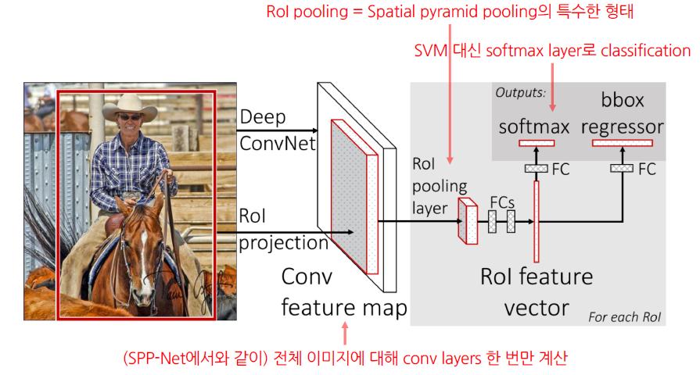
Fast R-CNN: Overview

Slide 23
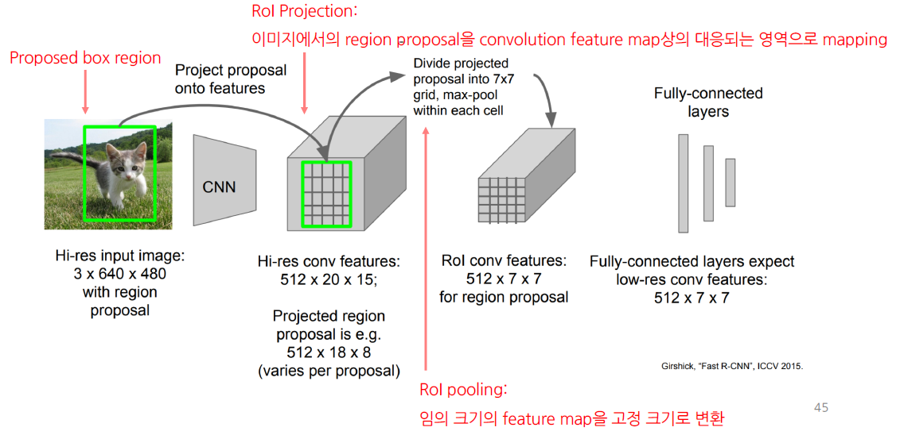
Fast R-CNN: RoI Pooling
by Selective Search

Slide 24
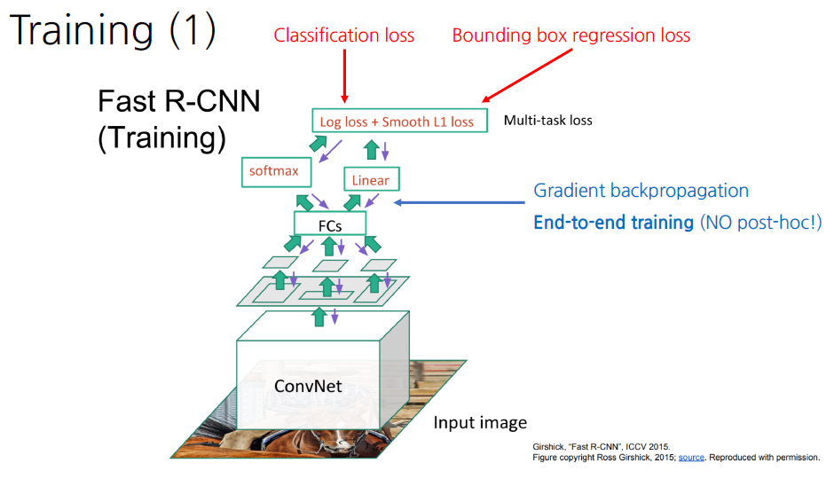
Fast R-CNN: Training

Slide 25
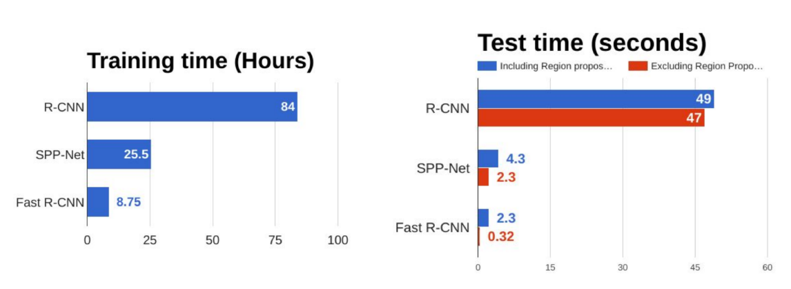
Fast R-CNN: Performance

Slide 26
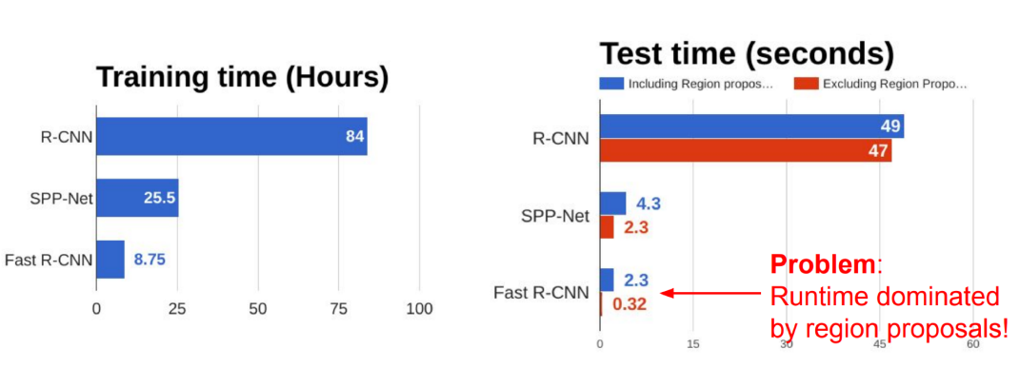
Fast R-CNN: need a real-time system!

Slide 27
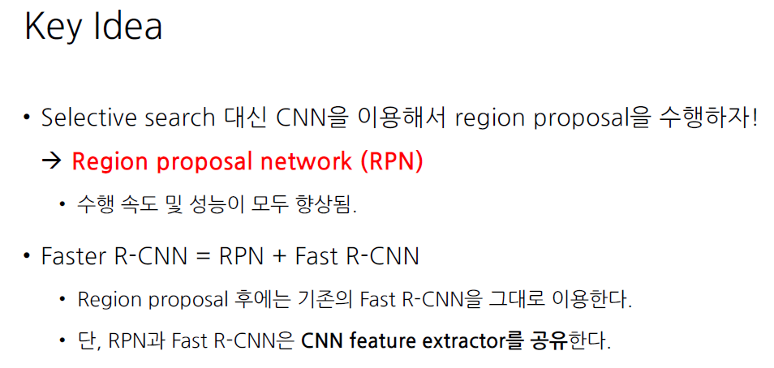
Faster R-CNN

Slide 28
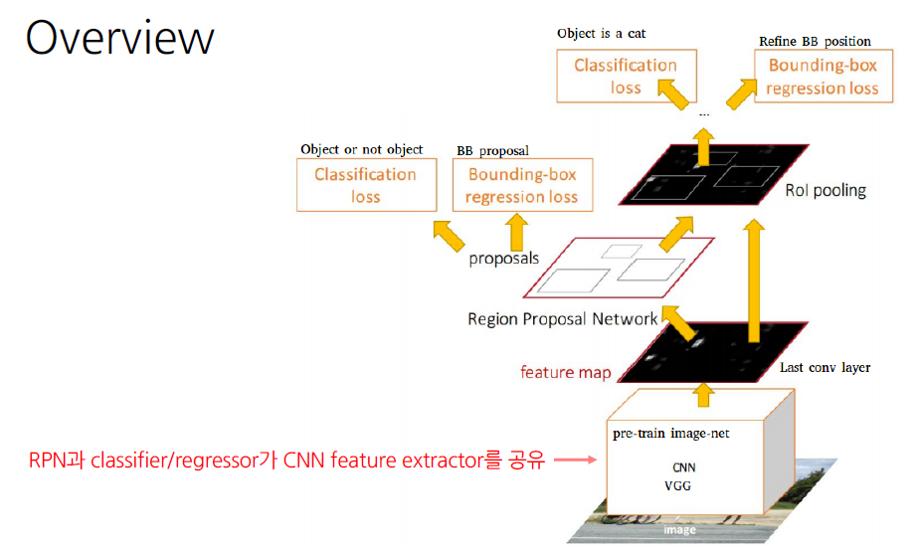
Faster R-CNN: Overview

Slide 29
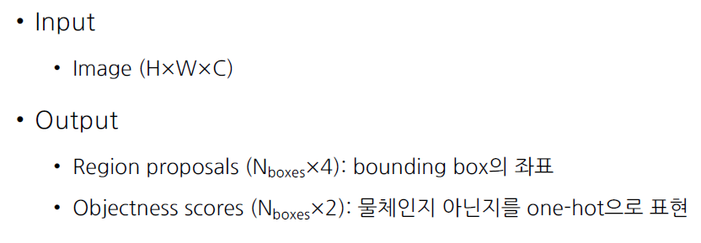
Faster R-CNN: RPN(1/3)
RPN(Region proposal network)

Slide 30
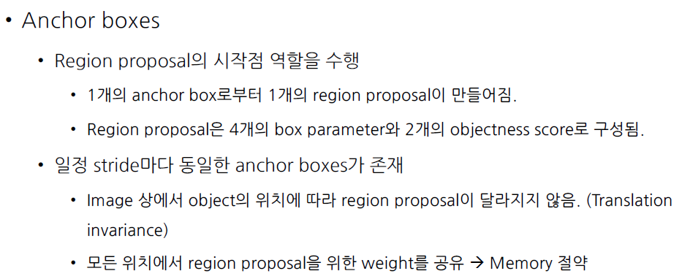
Faster R-CNN: RPN(2/3)

Slide 31
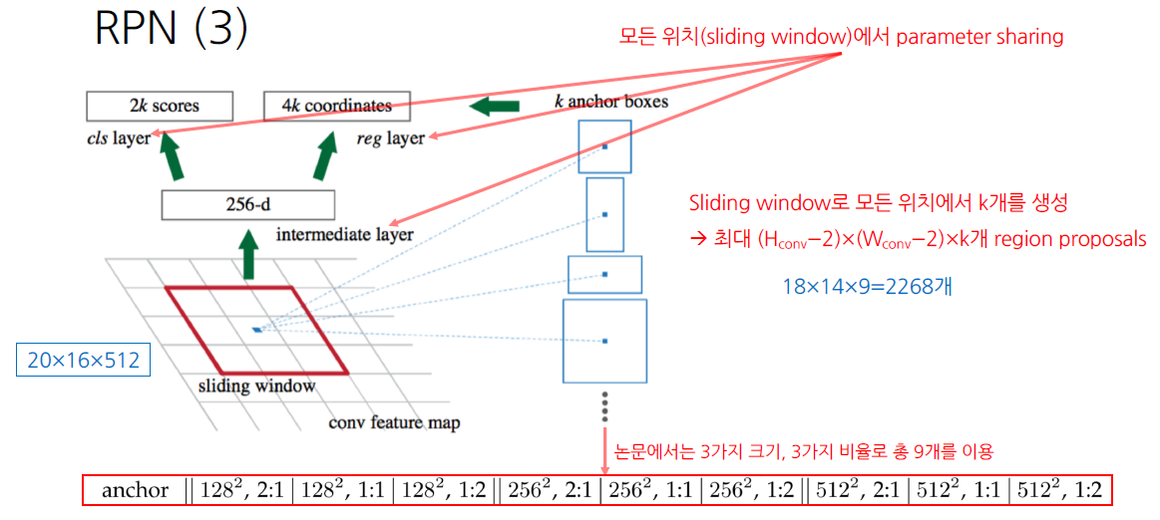
Faster R-CNN: RPN(3/3)

Slide 32
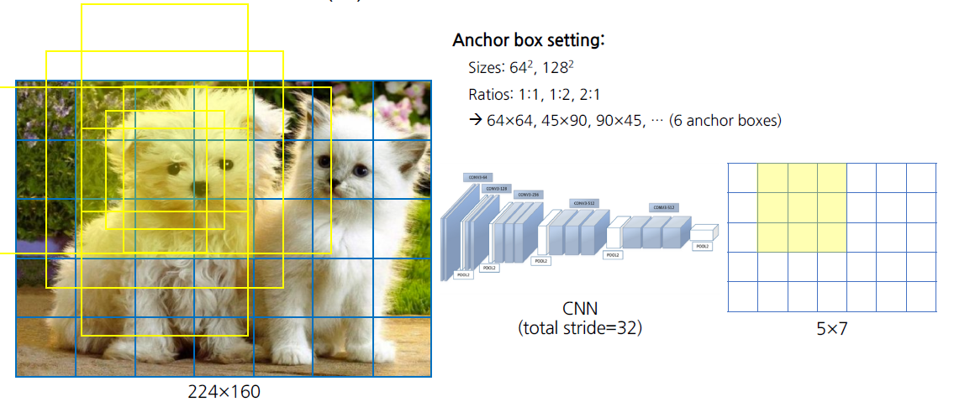
Faster R-CNN: Anchor Boxes

Slide 33
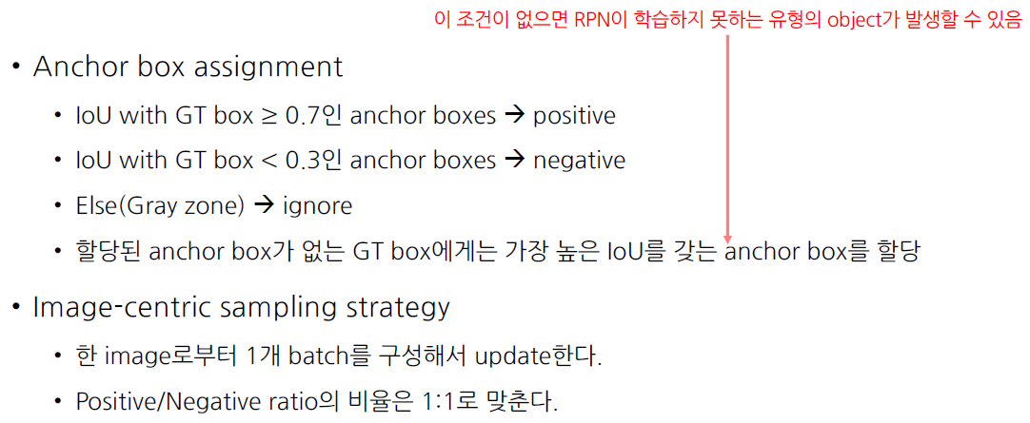
Faster R-CNN: Training RPN

Slide 34
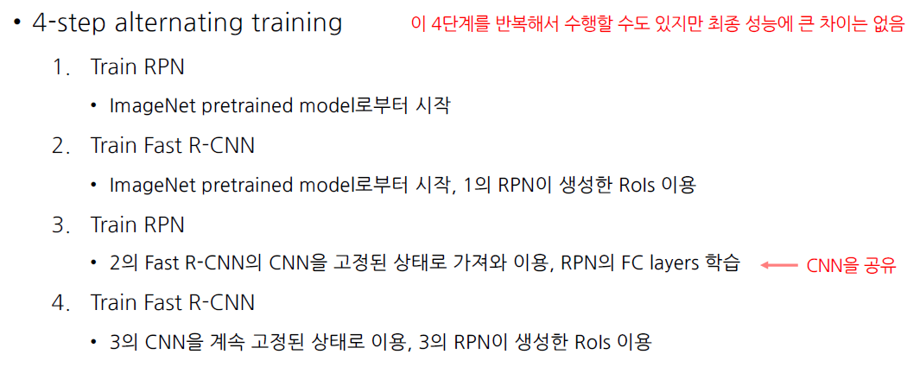
Faster R-CNN: Training

Slide 35
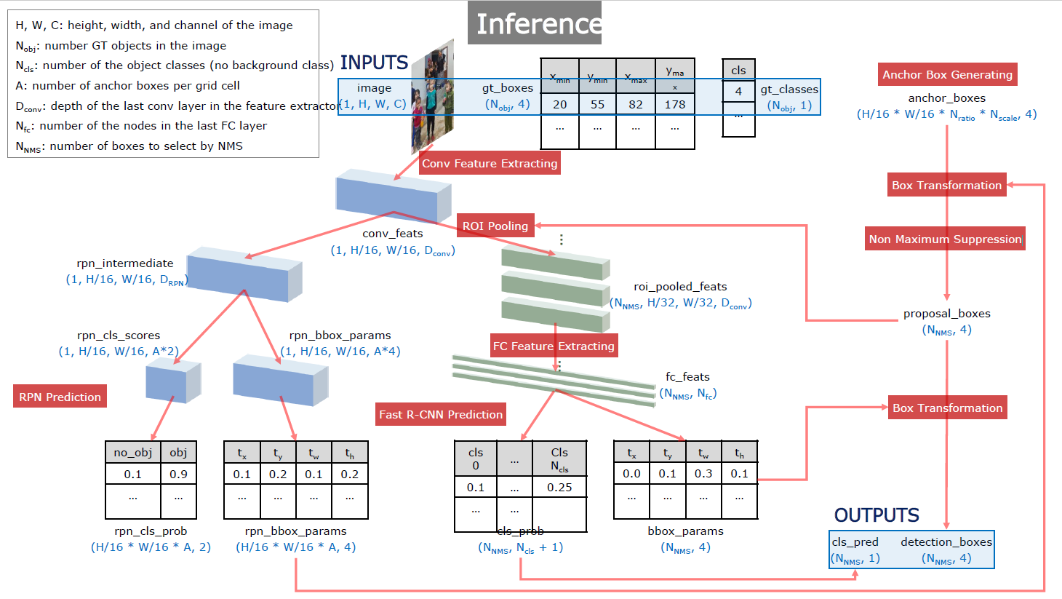
Faster R-CNN: Inference
①
③
NMS: 중복제거
④
⑤
②

Slide 36
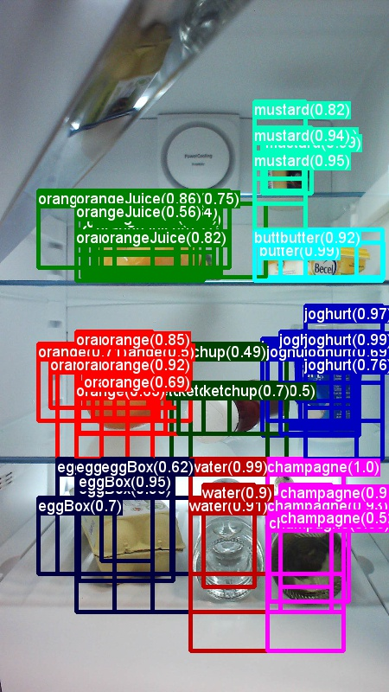
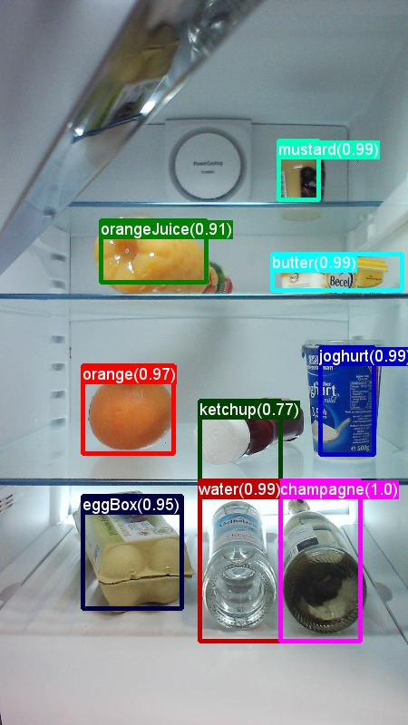
(참고) NMS(None Maximum Suppression)
NMS

Slide 37
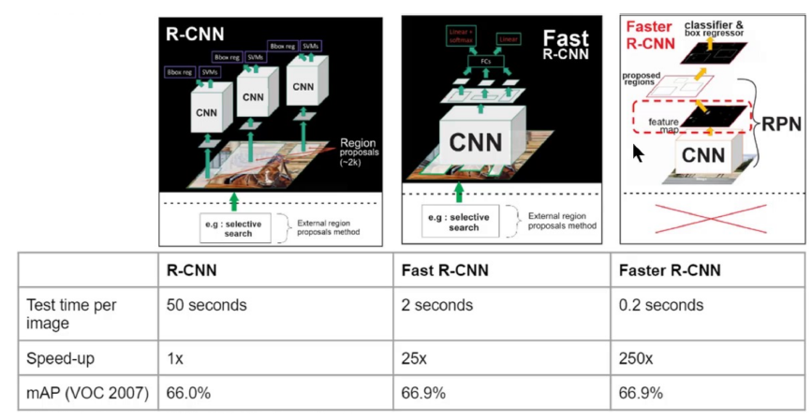
Faster R-CNN: Result

Slide 38
Q&A

Slide 39
